Slide 1
Course Title: Labor Economics
Corse No.: Econ 510
Reference Book: The Economics of Labor Markets
Authors:
Bruce E. Kaufman (Georgia State University)
Julie L. Hotchkiss (Georgia State University)

Slide 2

Chapter 1: The Labor Market
Chapter 2: Hours of Work
Chapter 3: Labor Force Participation
Chapter 4: The Demand for Labor in the Short Run
Chapter 5: The Demand for Labor in the Long Run
Chapter 6: Determination of Wages
Chapter 7: Education, Training, and Earnings Differentials: The Theory of Human Capital
Chapter 10: The Economics of Human Resource Management

Slide 3

ITEMs | Description | Score
Tutorial Exam | Out of 2 exams best 1 will be considered | 10
Term Paper [Mandatory] | Paper has to be submitted and presented by every student. | 10
Attendance | As per University guidelines | 10
 | Sub-total | =30
Final Exam | Full syllabus | 70
 | Grand Total | =100

Slide 4

Economics is concerned with the general question of resource allocation and the determination of prices and level of production in the economy.
Labor economics focuses on one particular aspect of this process, the determination of wages and employment in the labor market and the resulting distribution of income among individuals and households.
The focus of labor economics is on the world of work- who is working, what type of job are available, and why people are being paid what they are.

Slide 5

It has so many applications to current social issues and public policy debates. Should the minimum wage be raised? Should it be abolished? Why is the unemployment rate for blacks twice that for whites? Do unions cause inflation? Will technological change lead to greater unemployment?

Slide 6

Labor Market: A market exists whenever there is a good or service for which there are buyers (demanders) and sellers (suppliers) who engage in mutual exchange or trade of the item. This exchange or trade is typically consummated when there is common agreement on the price per unit that buyer must pay the seller.
Fig: Circular flow model of the economy

Slide 7

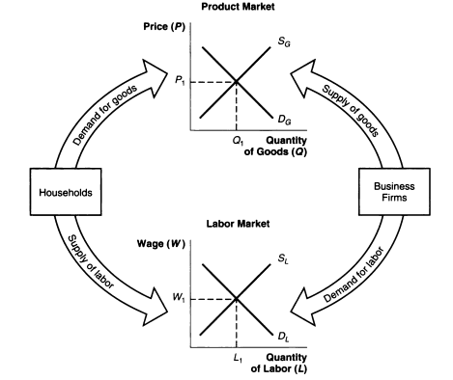

Slide 8

There are several ways in which the labor market differs from product markets in its structure or characteristics. The following features are unique for labor market:
Labor is embodied in the seller
The long-term nature of the employment relationship
Heterogeneity of workers and jobs
Multiplicity of Markets

Slide 9
Labor is embodied in the seller:
The ownership and possession of a commodity such as wheat is completely transferable between buyer and seller and, thus, neither party has any interest in the personal characteristics of the other (for instance, age, gender, color, or personality); only the interest of each party is to secure the most advantageous price possible. Likewise, the wheat, since it is an inert commodity, does not have any preference as to where and to whom it is sold.

Slide 10

The long-term nature of the employment relationship:
With many goods and services, such as automobiles, clothing, or airline travel, buyers and sellers may switch from one to another on a daily basis in pursuit of the most attractive price.
However, employers, for example, find it to their advantage in normal times to cultivate stable work-forces, since they make substantial investments in workers in the form of costs of hiring and, more important, training and experience.
Likewise, individual workers often find it to their advantage to remain with one employer for a considerable time. Because:

Slide 11
The long-term nature of the employment relationship:
Likewise, individual workers often find it to their advantage to remain with one employer for a considerable time. Because:
The wages and fringe benefits normally increase with tenure on the job. And
More psychological reason is related to the value people place on security and familiar surroundings.
The most important implication is that it reduces the sensitivity of wages to changes in demand and supply, and thus ability of wages to clear the market.

Slide 12
Heterogeneity of workers and jobs:
Individual workers differ by age, race, gender, education, experience, skills, and complex personality factors, such as motivation and congeniality. While a firm may have several types of machinery to choose from in making its product, every single worker it interviews is in some way unique.
In choosing between employers, workers face the some diversity in characteristic of jobs. Employers and jobs, for example, differ in the type and difficulty of the work, commuting distance, fringe benefits, and quality of employee relations, as well as wages.

Slide 13
Multiplicity of Markets:
There is a multiplicity of markets separated by geographical location, occupation, skill, and so on.
In analyzing the determination of wages, it is obvious that a distinction should be made between the market for plumbers, teachers, and bankers, for example, since the supply and demand for each occupation is likely to be quite distinct.

Slide 14

Labor market outcomes are the observed events, behavior, or development in the labor market. The outcomes represent the end product or final result of the operation of the labor market. The following five outcomes of the labor market are:
The changing level and composition of labor supply
The changing level and composition of labor demand
The Structure of Earnings
Labor-Management Relations and collective Bargaining
Changes in the level and composition of Unemployment

Slide 15

Labor is a factor input into the production of goods and services and thus, the quantity and quality of labor that individuals are willing to supply for market work is an important determinant of the economy’s level of production and rate of growth.
The quantity of labor supply depends on—
The size of the population
The proportion of the population that desire to work.
The hours of work per year

Slide 16

The quality of labor supply depends on—
The level of education;
Skill; and
Health of the workforce.
During the post-World War II period, dramatic changes in the size and composition of labor supply have taken place, specially—
The average number of hours worked per year by all workers between 1900 and 2001 has been declined.
Labor participation rate of men and women had been changed remarkably.
The rapid increase in the educational attainment of the workforce.(4% (1940) to 26%(2001))

Slide 17

One important feature of employers’ demand for labor is the growth over time in the total number of jobs made available. This can be witnessed by the large-scale expansion of employment in the economy from 60 million to 132 million between 1950 to 2001.
Another significant attribute of labor demand is the types of jobs that are available in the economy. Demand for goods and services produced in the product market of the economy shifts overtime. In reaction to this, the demand for labor expands in some occupations and industries while it contracts in others, leading to large changes in the skills, education, and geographic locations required of workers.

Slide 18

The third labor market outcome concerns the differences in earnings among individual workers, occupations, industries, and geographical areas.
One of the tasks of labor economics is to identify the factors responsible for this particular spread in earnings.
Educational qualification, unionization, gender, full-time and part-time employee etc. are responsible for earnings differentials.
A second important aspect of the structure of earnings concerns the change in earnings differentials over time-
Earnings differentials varied industry to industry.

Slide 19

The percentage of the workforce belonging to unions has also not been constant over time, showing steady decline since the 1950s.
In 1950s, approximately 35% of the nonagricultural workforce belonged to union, by 2001, the proportion had dropped to 13.5% . Many factors were responsible like—
Shift from goods to service producing economy
Govt. regulation of the employment environment and protection of the worker rights.
The growth in union avoidance activities by employers.

Slide 20

A person is identified as unemployed when he or she does not have a good job and has made an active effort in the previous four weeks to find one.
Unemployment entails costs both to the individual worker because of the consequent loss of earnings and to society because of the loss of goods and services that could have been produced with that labor input.

Slide 21
Two aspects of unemployment are of particular importance.
The first is the overall level of unemployment and its change over time.
An area of public concern regarding unemployment, which is unequal distribution among different group in the labor force.

Slide 22

The labor market process involves the following three broad forces that together determine each of the outcomes:
1) Market forces
2) Institutional forces
3) Sociological forces

Slide 23

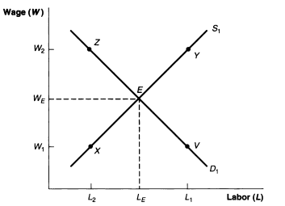
The first process to consider in the determination of the price and allocation of labor is the market forces of supply and demand in the labor market.
Fig.1: Determination of wage rates by demand and supply

Slide 24

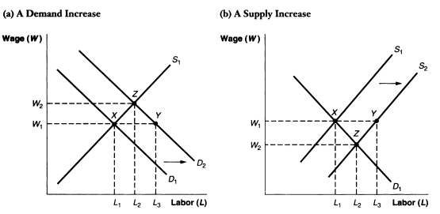
Fig.2 The market adjustment to shifts in demand and supply.

Slide 25

Govt. also has a wide influence on wages that transcends market forces. Examples are minimum wage floors, prevailing wage standards in govt. construction, and legislated wage increases for govt. employees.

Slide 26
Institutional forces represent the influence of various organization such as unions, governments, and corporations on the pricing and distribution of labor.
Institutions, however, introduce rules and regulations that further define the dimensions of the labor market. These rules and regulations may be either formal (written) or informal (customary).
Large business firms and govt. also have an institutional influence on wages.

Slide 27

The third determination of labor market outcomes is sociological forces, which represent the influence of social groups and norms on the determination of wages and the allocation of labor.
Important factors include family background, class, cultural, discrimination, and custom.

